Slide 1
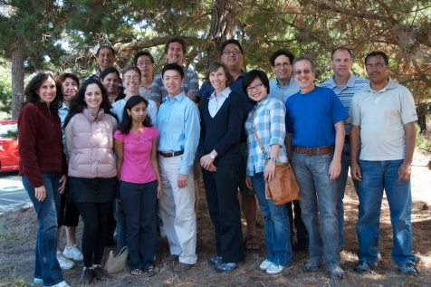
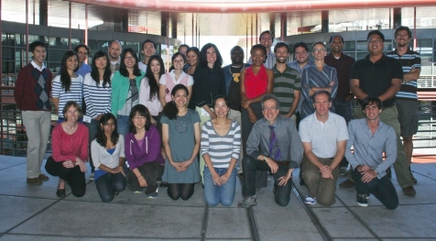
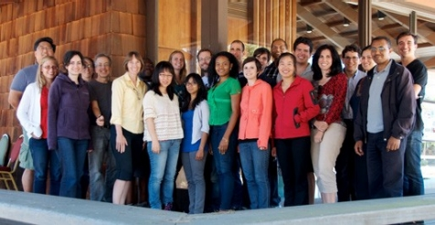
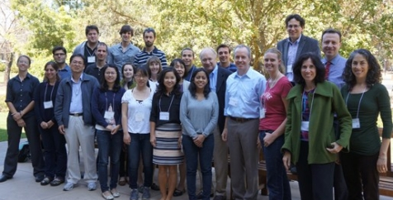

IBIIS: Integrative Biomedical Imaging Informatics at Stanford
2011
2012
2013
2014
IBIIS Retreat 2013

Slide 2
IBIIS Vision Statement
Revised 2015
Leveraging the biomedical information in growing collections of medical images, together with other health and biological data, to better understand disease and to improve human health at the patient and population scales.

Slide 3
IBIIS Mission Statement
Revised 2015
To develop and validate methods, tools, and integrated databases that enable extracting and combining information from biomedical images with other health data to drive innovations and discoveries that improve human health.

Slide 4
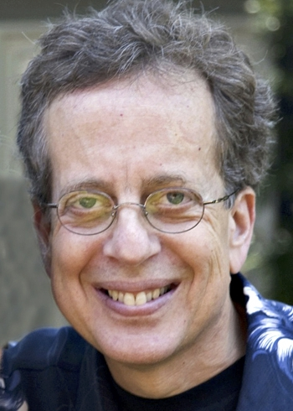
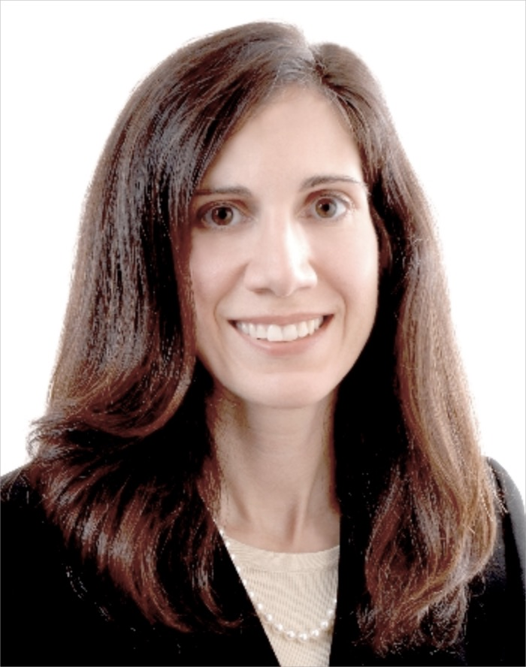
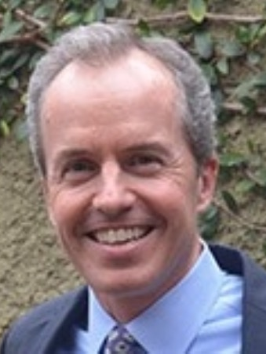
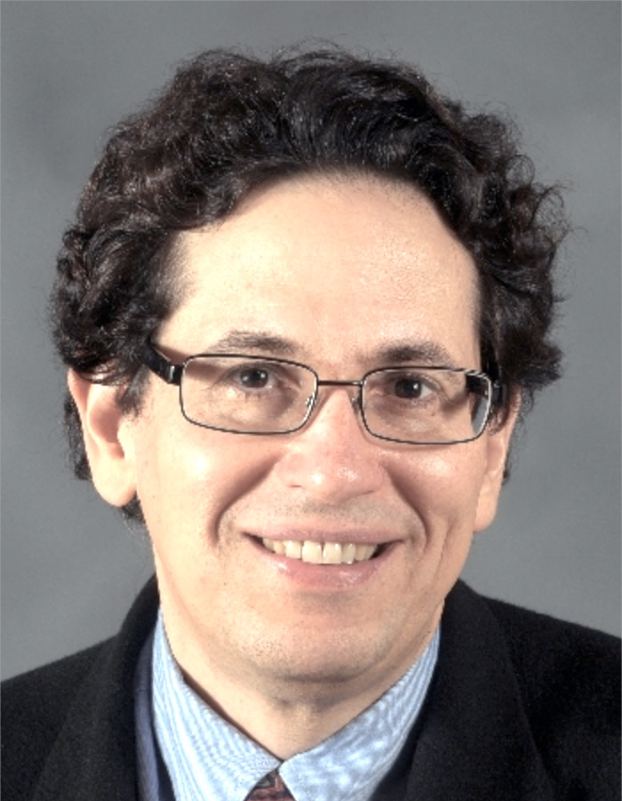
Core IBIIS Faculty
Sandy Napel, PhD
Professor Radiology,
Co-Section Chief
Sylvia Plevritis, PhD
Professor
Radiology,
Co-Section Chief
Fellow of AIMBE 2014
Dist. Invest. ARR 2014
Curtis Langlotz, MD, PhD
Professor Radiology,
Associate Chair Information Technology
Daniel Rubin, MD, MS
Associate Professor,
Radiology
RSNA Outstanding Educator (2 Years)
Notes:
Curt newest, about one year, links us in tightly to the clinical enterprise for radiological knowledge and infrastructure for radiology research (PACS, RIS, Research PACS, etc.)

Slide 5
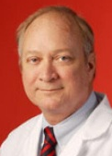
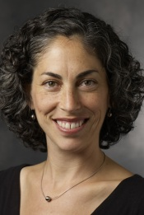
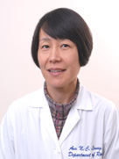
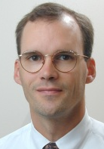
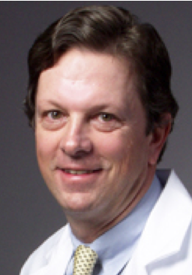
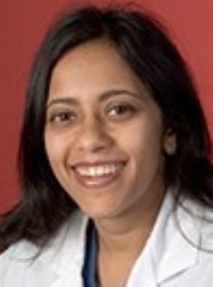
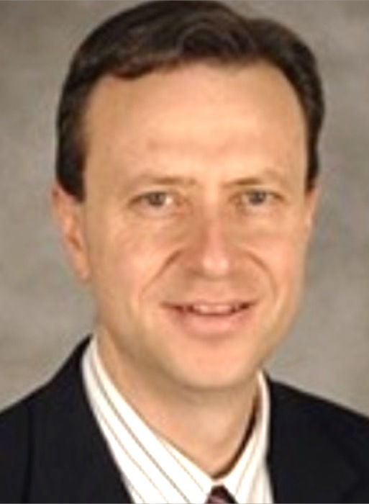

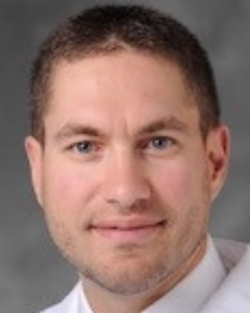
Affiliated IBIIS Faculty
Robert Herfkens, MD
Professor, Radiology
Jafi Lipson, MD
Assistant Professor, Radiology
Ann Leung, MD
Professor, Radiology
Associate Chair, Clinical Affairs; Chief of Thoracic Imaging
Chris Beaulieu, MD, PhD
Professor, Radiology
Chief of Musculoskeletal Imaging
R Brooke Jeffrey Jr., MD
Professor, Radiology
Associate Chair, Academic Affairs
Nishita Kothary, MD
Associate Professor, Radiology
David Larson, MD
Associate Professor, Radiology
Associate Chair of Performance Improvement
Parag Mallick, PhD
Assistant Professor, Radiology
Canary Center for Early Detection of Cancer
Safwan Halabi, MD
Assistant Professor, Radiology
Pediatric Radiology
Notes:
Say: active affiliated faculty, for example:
Ann Leung: radiogenomics of non-small cell lung cancer
Jafi Lipson: breast density (with Daniel and 3DQ lab); breast MR tumor heterogeneity
Nishita: radiomics/radiogenomics of HCC for evaluation of tumor transplant candidates

Slide 6
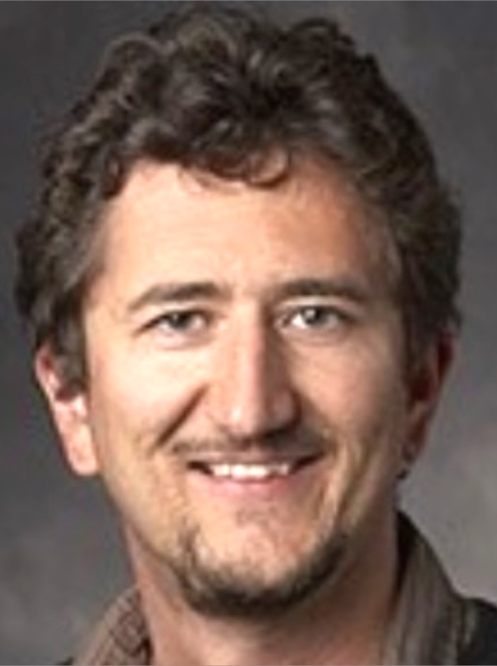
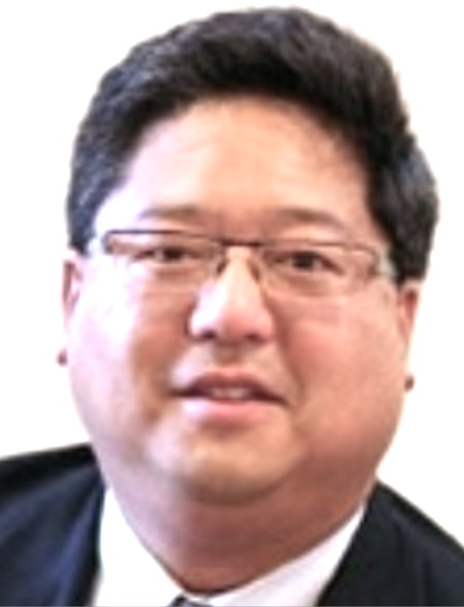
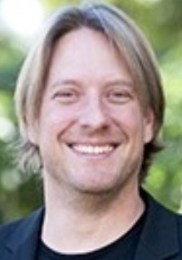
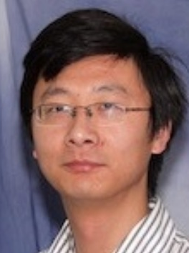
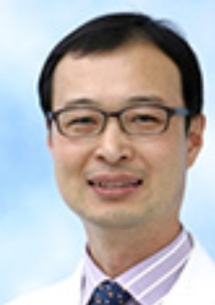
Affiliated IBIIS Faculty
David Paik, PhD
Consulting Assistant Professor, Radiology
Director, Imaging Science at Elucid Bioimaging Inc.
Olivier Gevaert, PhD
Assistant Professor, Biomedical Informatics Research
Killian Pohl, PhD
Adjunct Assistant Professor, Department of Psychiatry & Behavioral Sciences
Ruijiang Li, PhD
Assistant Professor of Radiation Oncology
Visiting IBIIS Faculty
Byoung Wook Choi, MD
Professor & Chief , Department of Radiology, Yonsei University Hospital, Korea
Notes:
Say: active affiliated faculty, for example:
Olivier Gevaert: radiogenomics of non-small cell lung cancer
Ruijiang Li Predicting distant metastasis in early-stage lung cancer by integrating PET and CT

Slide 7
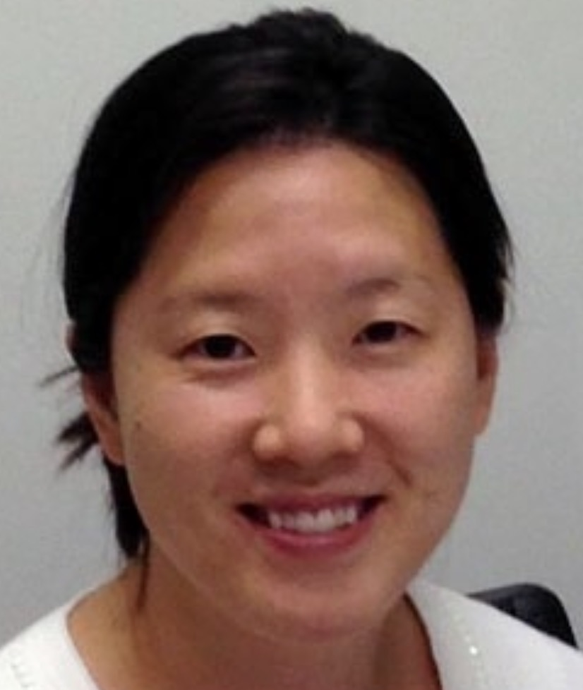
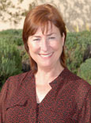
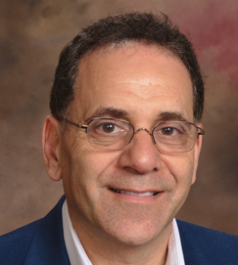
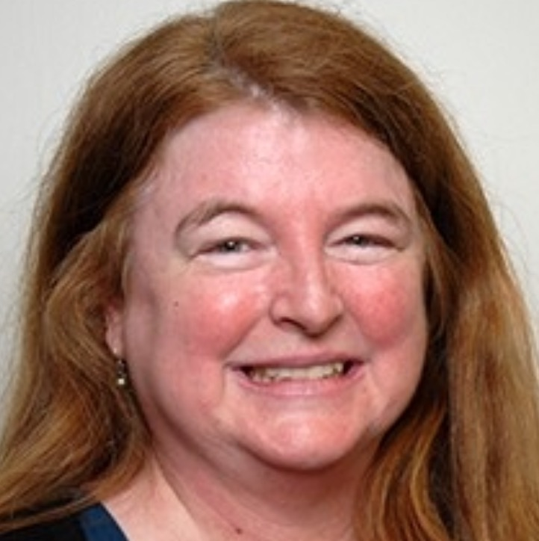
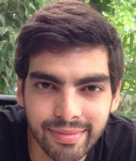
IBIIS Administrative Staff
Holly Chung Program Manager: IBIIS, CCSB, CSBS R25T
Maggie Bos
Admin Assistant:
Sylvia Plevritis
Fuad Nijim
Admin Assistant:
Daniel Rubin
Elizabeth Colvin
Admin Assistant:
Sandy Napel,
Curt Langlotz,
3DQ Lab
Ramzi Totah
Admin Assistant:
CCSB, CSBS

Slide 8
IBIIS Research Teams: 36 members
13 Staff Members:
  2 Research Associates
  5 Software Developers
  3 Program Managers
9 Postdoctoral Fellows
14 Graduate Students:
  6 BMIR
  5 EE
  1 Biophysics
  2 Cancer Biology

Slide 9
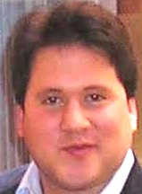
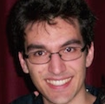

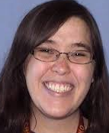
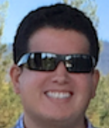
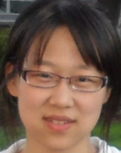
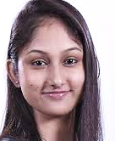
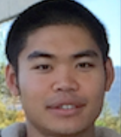
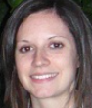
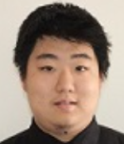
IBIIS Grad Students
Diego Munoz
Alborz Bejnood
Francisco Gimenez
Melissa Ko
Sebastian Echegaray
Tiffany Liu
Reema Baskar
Yu Yan
Rebecca Sawyer
Darvin Yi

Slide 10

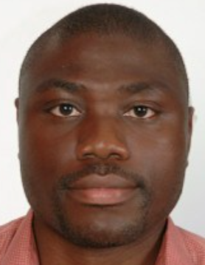
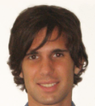
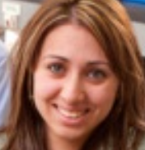
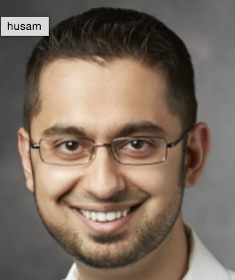
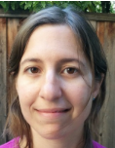
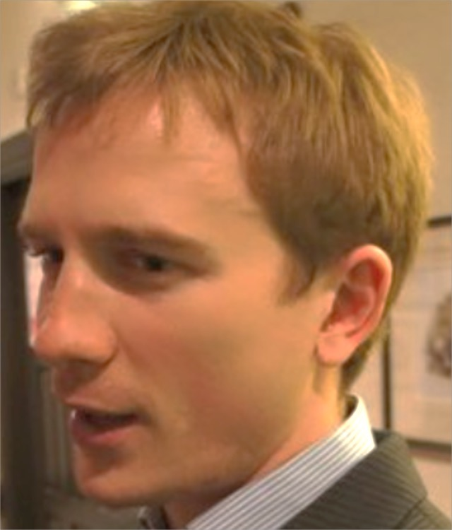
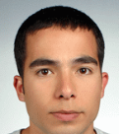
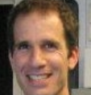

IBIIS Postdocs
Weiruo Zhang
Benedict Anchang
Luis de Sisternes
Loukia Karacosta
Majid Shafiq
Marina Bendersky
David Knowles
Hakan Bulu
Assaf Hoogi
Jacob Toumazis

Slide 11
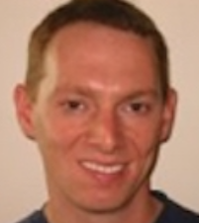

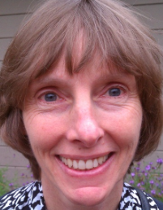
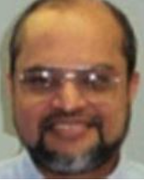
IBIIS Research Staff
Andrew Gentles
Summer Han
IBIIS Software Developers
Cavit Altindag
Emel Alkim
Debra Willrett
Dev Gude

Slide 12
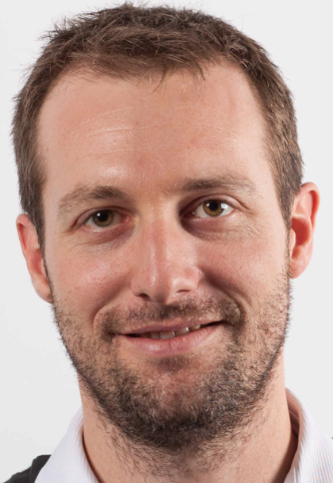
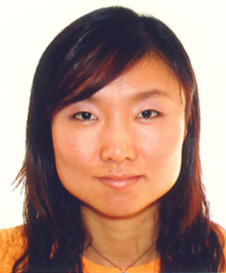
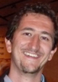
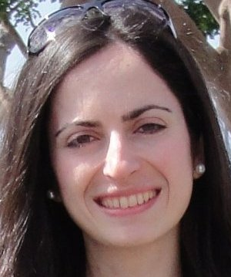






Recent IBIIS Graduates
Adrien Depeursinge, PhD Assistant Professor
    University of Applied Sciences and Arts, Switzerland
Xi Zhoa, PhD
Bioinformatics Scientist
Gilead Sciences
Olivier Gevaert, PhD
Assistant Professor
    Stanford University (BMIR)
Ayca Erdogan, PhD
Assistant Professor Industrial Engineering
San Jose State
Ramesh Nair, PhD
Senior Bioinformatician Stanford Center for Excellence in Stem Cell Genomics
Jessica Faruque, PhD
Post-doc, National Library of Medicine
Jocelyn Barker, PhD
Post-doc, IBIIS Rubin Lab
Xi Rao, PhD
Biocomputational Post-doc fellow at Indiana University
Saeed Hassanpour, PhD
Assistant Professor, Dartmouth University
Selen Bozkurt, PhD
Assistant Professor, Akdeniz University

Slide 13
Courses
    Biomedin 260: Computational Methods for Biomedical Image Analysis and Interpretation (Rubin/Paik, Spring Quarter)
    BMI 205: Precision Practice with Big Data (Rubin)
    CBIO 243: Principles in Cancer Systems Biology (Plevritis, Spring Quarter)

Slide 14




IBIIS Monthly Seminars
July 23, 2015: Camille Kurtz, PhD
University of Paris Descartes
Semantic Features for Automated Retrieval of Radiologic Images
July 23, 2015: Germain Forestier, PhD
University of Haute-Alsace, France
Automatic analysis of whole slide images in digital pathology
Oct 21, 2015: Michael Greicius, MD, PhD
Stanford University
Imaging, Genetics, and Imaging Genetics: Insights into Alzheimer’s Disease
Nov 18, 2015: Vittorio Cristini, PhD
University of New Mexico
Molecular Modeling of Cancer

Slide 15
IBIIS Affiliated
Programs & Activities

Slide 16





Stanford Cancer Imaging Training (SCIT) Program
Erica Cherry, PhD
10/1/2013 – 9/30/2015
Imaging during radiation therapy
Tzu-Yin Wang, PhD
1/1/2014 – 12/31/2015
Ultrasound molecular imaging
  Sandy Napel & Graham Sommer, co-Program Directors
  2 Year NCI-sponsored fellowships
  MDs get 6 months clinical training
  Paired Mentorship (PhD, MD)
Mehmet Gunhan Ertosan, PhD
2/21/2014 – 2/20/2016
Image classification by deep learning
Saeid Zanganeh, PhD 2/24/2014 - 2/23/2016
Imaging agent inhibits tumor growth
Ryan Spitler, PhD
9/1/2014 - 8/31/2016
Magnetogenic cancer therapy

Slide 17




Stanford Cancer Imaging Training (SCIT) Program
Subashini Srinivasan, PhD 9/1/2015 – 8/31/2017
MR-guided augmented reality for breast-conserving therapy
Siavash Yousefi, PhD
9/1/2015 – 8/31/2017
Image-guided range verification for proton beam therapy
  Sandy Napel & Graham Sommer, co-Program Directors
  2 Year NCI-sponsored fellowships
  MDs get 6 months clinical training
  Paired Mentorship (PhD, MD)
Josh De Bever, PhD
tba
MR-guided focused RF ablation of cancer
Hamid Arami, PhD
tba
Molecular Imaging and Nanomedicine for Stem Cell Imaging and Therapy

Slide 18

Stanford Cancer Imaging Training (SCIT) Program
  Sandy Napel & Graham Sommer, co-Program Directors
  2 Year NCI-sponsored fellowships
  MDs get 6 months clinical training
  Paired Mentorship (PhD, MD)

Slide 19

Center for Cancer Systems Biology http://ccsb.stanford.edu
Monthly CCSB Seminars
Annual CCSB Symposium
  4th Annual Symposium: October 22, 2015, Berg Hall, Li Ka Shing
NCI Summer Internships
Computational Biology Track in Cancer Biology PhD Program

Slide 20
R25T CSBS Training Program http://med.stanford.edu/csbs
  2 Year NCI-sponsored fellowships
  Co-mentorship in Cancer Biology & Biocomputation
  Five inaugural fellows started September 1, 2015
    Krystal Straessler (Alejandro Sweet-Codero, Christina Curtis)
    Mohammad Shahrock (Ash Alizadeth, Rob Tibshirani)
    Ryan Corces-Zimmerman (Howard Chang, Wing Wong)
    Chris McFarland (Dimitri Petrov, Monte Winslow)
    Loukia Karacosta (Sylvia Plevritis, Garry Nolan)

Slide 21









Radiology 3DQ Lab
Co-Directors: Bammer, Fleischmann, Napel
Clinical, Research and Education Missions
11 technologists; 3 manager/technologists
http://3dqlab.org
Notes:
3D and quantitative medical imaging
CT angiography, virtual colonscopy, sliding thin slab maximum intensity projection images,

Slide 22



Radiology 3DQ Lab
Hans-Christoph Becker, MD
Professor of Radiology
Director of Oncological Imaging
http://3dqlab.org
Notes:
3D and quantitative medical imaging
CT angiography, virtual colonoscopy, sliding thin slab maximum intensity projection images,

Slide 23


Radiology 3DQ Lab
Core Lab for Quantitative Imaging Projects
Breast Density with Weiva Sieh (Health Research and Policy)
Predictive Biomarkers For Cancer Therapy-induced Tissue Damage In Children with Heike Daldrup-Link (Pediatric Radiology)
http://3dqlab.org
Notes:
3D and quantitative medical imaging
CT angiography, virtual colonoscopy, sliding thin slab maximum intensity projection images,

Slide 24
IBIIS Research Activities

Slide 25
Representative IBIIS Funding
(of ~ 25 grants)
U01 CA142555 (Rubin): Computerized Quantitative Imaging Assessment of Tumor Burden
U01 CA190214 (Rubin): Qualification and Deployment of Imaging Biomarkers of Cancer Treatment Response
U01 CA187947 (Napel/Rubin): Computerized Quantitative Imaging Assessment of Tumor Burden
R01 R01 CA160251 (Napel/Plevritis): Tools for Linking and Mining Image and Genomic Data in Non-Small Cell Lung Cancer

Slide 26
Representative IBIIS Funding
(of ~ 25 grants)
U54 CA149145 (Plevritis): Modeling the Role of Differentiation in Cancer Progression
U01 CA152958 (Plevritis): Comparative Modeling: Informing Breast Cancer Control Practice & Policy
U01 CA152956 (Plevritis): Comparative Modeling of Lung Cancer Control Policies
U01 CA154969 (Plevritis): Clinically Relevant Regulatory Networks in the Lung Tumor Microenvironment

Slide 27
Representative IBIIS Funding
(of ~ 25 grants)
HHSN268200800020C (Rubin/Langlotz): Unification of RadLex Playbook and LOINC Radiology Codes
RSNA (Langlotz): RSNA Informatics Advisor

Slide 28









Radiogenomics of Non-small Cell Lung Cancer
R01 CA160251
`
`
Image
features
survival
response to therapy
etc.
discover relationships
cluster
genes
metagenes

Slide 29

Tumor Identification & Semantic Annotation
Rubin Lab, U01 CA142555

Slide 30
Tumor Identification & Semantic Annotation
Rubin Lab, U01 CA142555
243 registered ePAD users, in USA and 6 other countries
Used in 10 Stanford projects
Used by NCI and its grantees
    TCIA/TCGA
    Quantitative Imaging Network challenges
Plug-in architecture for expansion of functions

Slide 31

Information Extraction from Narrative Radiology Reports
Langlotz Lab
Stanford Part of Speech Tagger
Porter stemmer
Word shape from Stanford CoreNLP toolkit
NegEx to detect negation
RadLex ontology class
Report information extraction tool
Information model
Machine learning/NLP
Annotated radiology reports
“A 1cm calcified mass probably is present in the anterior right upper lobe”
Anatomy: “right upper lobe”
Anatomy modifier: “anterior”
Observation: “mass”
Observation modifiers: “calcified”, “1cm”
Uncertainty: “probably is present”
Unannotated radiology reports
Information linkage, summarization
real-time decision support for radiologists
Notes:
Wouldn’t it be great if the semantic annotations could be gotten from radiology reports? Well there is a long way to go; even going from a narrative to a structured report is challenging, a subject of natural language processing research.
Curt’s lab has taken steps in that direction by using machine learning to categorize words in reports as objects, such as Anatomy right upper lobe), Anatomy Modifier (anterior), modality, Observation (mass), Observation modifier (calcified, size of) and notions of uncertainty (probably), by starting with a large corpus of reports and manually classifying words and then bootstrapping, and then correcting and bootstrapping again. Once there is a mapping generated by the machine learning system, it can be applied to an un annotated report as shown. Ultimately, this real time categorization can be fed into real time decision support for radiologists.

Slide 32


Nov. 2014
Martin Epstein Award
Notes:
Missing descriptors in mammography reports do not necessarily mean that the report does not have all the information to make a correct and justified diagnosis (benign, malignant). However, it is possible that the inclusion of some missing observations would change the diagnosis.
They used Monte Carlo Simulation on almost 25,000 mammography reports to compute an incompleteness score, i.e,, the probability that a given decision will change given new information
They showed that this score has over an 80% accuracy predicting errors in interpretation and can reduce diagnostic errors by over 20%.
Future work would involve giving this feedback to mammographers during the report generation process to reduce diagnostic errors in real time.
For more information talk to Francisco Gimenez who is here and come visit our posters.

Slide 33

Cloud-based Quantitative Feature Pipeline
Napel & Rubin Labs U01 CA187947

Slide 34


Sept 7, 2015
Notes:
Example of Project Run by Another Lab with technology projects led by IBIIS faculty. For example, in this recently published paper, Olivier Gevaert worked with our image feature pipeline to extract features such shape, texture, and edge sharpness of each lesion from MR images Three distinct phenotypic “clusters” emerged. Each of these three clusters—pre-multifocal, spherical, and rim-enhancing, names reflecting their image features--mapped to a unique set of molecular signaling pathways using pathway activity estimates derived from the analysis of TCGA tumor copy number and gene expression. Distinct pathways, such as c-Kit and FOXA, were enriched in each cluster, indicating differential molecular activities as determined by the image features. Each cluster also demonstrated differential probabilities of survival, indicating prognostic importance. Our imaging method offers a noninvasive approach to stratify GBM patients and also provides unique sets of molecular signatures to inform targeted therapy and personalized treatment of GBM.

Slide 35



Pathology Image Analysis Reveals Gender Subtypes Affecting Patient Survival in Gliomas
Jocelyn Barker, Rubin Lab
A
C
D
B
Notes:
This project looked at associations between image features in whole slide pathology and identified clinically-relevant gender-based differences in lower grade gliomas. (a) They developed quantitative analytical methods to process whole slide histopathology images in a collection of these tumors to find characteristics that distinguish males and females and to predict the gender from those features; (b) We divided patients into 4 groups depending on whether their gender could be predicted by the pathology features and whether they were actually male/female; this defines 4 patient subtypes; (c) those subtypes, unlike the pooled males/females, have significant differences in survival; (d) We performed differential expression analysis on these disease subtypes, and we discovered four genes (OTX2, MAGEC2, PITX2, and NUP62CL) associated with a detrimental phenotype in females and a beneficial one in males. These genes are involved in development of the pituitary gland—the brain region responsible for many sexually dimorphic traits. Our results indicate a putative mechanism for the observed gender-based differences in survival.

Slide 36

Gentles et al., Nature Medicine 2015.

Slide 37
Next Steps for IBIIS
Expand IBIIS faculty/activities
  Core faculty
  Affiliated faculty
Seek alliances with:
  new Department (Biomedical Data Sciences—Bustamante/Lavori)
  Biomedical Data Science Initiative, cross-campus, and part of Data Sciences@Stanford
Notes:
Search open last week, already 2 fantastic applicants

Slide 38
Visit Our Posters &
Talk to our Trainees
Many projects not mentioned are on display….
Notes:
Search open last week, already 2 fantastic applicants

Slide 39
Notes:
Search open last week, already 2 fantastic applicants

Slide 40
For next time
Make funding plots over time
Thank retreat committee
Introduce posters (kim flew over them…cross cut them into “who’s working on…?? Was neat)
Nice summary for stuents/post-docs,,, opportunities, networking
Notes:
Search open last week, already 2 fantastic applicants

